Slide 1

AUTOMOBILE INDUSTRY IN PAKISTAN + IMPACT ON NATIONAL ECONOMY
PRESENTED BY:
CAPT SUMEER RIAZ
PC HUMZA AAMIR

Slide 2
PRESENTATION COVERAGE
PART-I
OFFICIAL BODY (Pakistan Automotive Manufacture’s Association)
THE MARKET TREND (Cars)
DATA AND STATISTICS
PART-II
PROBLEMS AND FLAWS IN INDUSTRY
LOCAL MARKET ANALYSIS
GROWING VEHICLE IMPORT TREND
CONCLUSION

Slide 3
PART-I
OFFICIAL BODY (PAMA)
THE MARKET TREND (Cars)
DATA AND STATISTICS

Slide 4

PART-I
1.1 OFFICIAL BODY
Licensed by the Ministry of Commerce, Government of Pakistan under the Trade Organizations Ordinance 2007 and registered under the Companies Ordinance 1984 as a company with limited liability.
Objectives:
To play central role in all policy making process of the Government for the automotive industry of country.
To enable Pakistani Auto Industry in becoming a Global Player.
To provide the members with high quality professional service & create excellent communication.
To be the principal source of statistical data on the entire automotive industry of the country.
To play its role to foster harmony and accord amongst all stakeholders.

Slide 5
PART-I
OFFICIAL BODY (PAMA)
THE MARKET TREND (Cars)
DATA AND STATISTICS

Slide 6
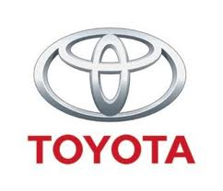


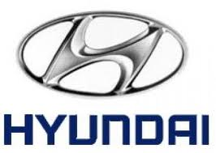

PART-II
1.2.1 THE MARKET TREND
CURRENT AUTOMOTIVE SECTOR
Pick-Ups
Hatchbacks
SUVs
Pick-Up
Saloons
Family Wagons
Hatchbacks
SUVs
Saloons
Family Wagons
Family Wagons
Saloons
Pick-Ups
Hatchbacks
Family Wagons
Saloons
Pick-Ups
Hatchbacks

Slide 7
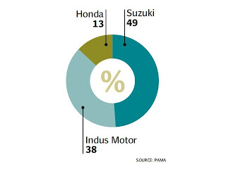
PART-II
1.2.2 THE MARKET TREND
LEADERS IN THE AUTOMOTIVE SECTOR
Image Link: http://www.riazhaq.com/2012/08/toyota-pakistan-auto-profits-up-57-in.html

Slide 8
PART-I
OFFICIAL BODY (PAMA)
THE MARKET TREND (Cars)
DATA AND STATISTICS

Slide 9

PART-I
1.3.1 DATA AND STATISTICS
Annual Production ranges from 100,000 to 170,000 vehicles.
Car sales touched record peak of 180,834 in 2006-07 thanks to rising car financing up to 70-80 per cent by banks due to low interest rates and rising rural buying.
The total contribution of Auto industry to GDP in 2007 was 2.8% which is likely to increase up to 5.6% in the next 5 years. Auto sector presently, contributes 16% to the manufacturing sector which is predicted to increase 25% in the next 7 years.
Investment of over Rs 20 billion in the last four to five years to meet growing demand.

Slide 10
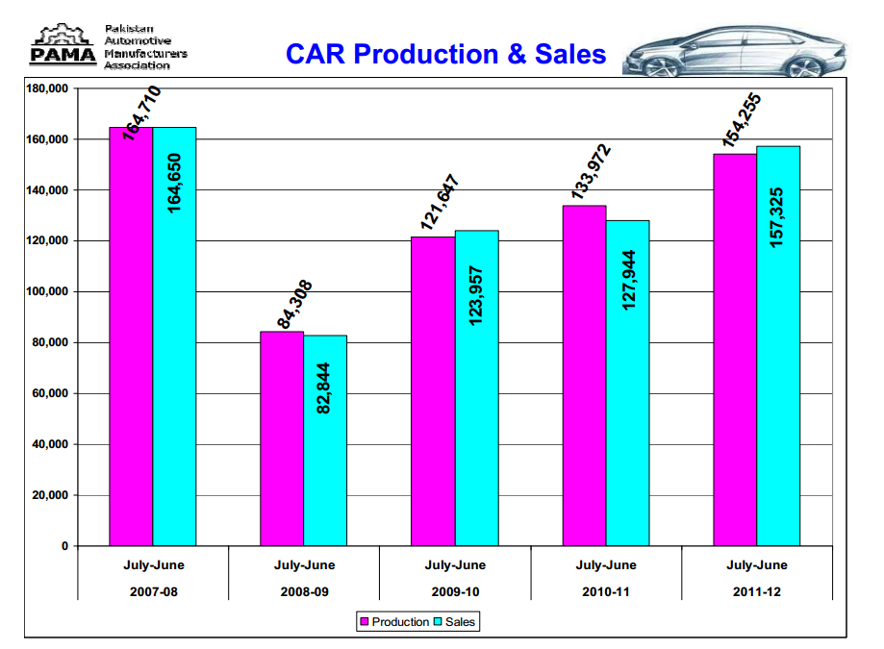
PART-I
1.3.2 DATA AND STATISTICS
Extracted from PAMA Archives

Slide 11
PART-II
PROBLEMS AND FLAWS IN INDUSTRY
LOCAL MARKET ANALYSIS
GROWING VEHICLE IMPORT TREND
CONCLUSION

Slide 12
PART-II
2.1 PROBLEMS AND FLAWS
Major reasons behind an ailing industry:
INFLATION
MONOPOLY OF MANUFACTURERS
ABSENSE OF NEW COMPETITORS
POOR QUALITY STANDARDS
USE OF OBSOLETE TECHNOLOGY

Slide 13
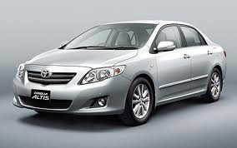
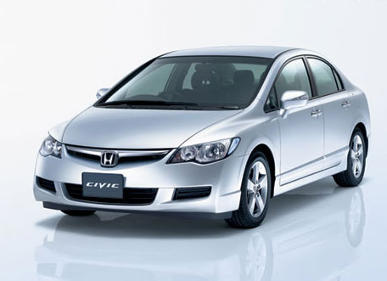
PART-II
2.2.1 LOCAL MARKET ANALYSIS
Top rivalry amongst saloon segment:
+
More market coverage and Good Resale Value
+
Better Design, Quality and Performance
TOYOTA COROLLA ALTIS
HONDA CIVIC VTI ORIEL
__
BLAND DESIGN & POOR REFINEMENT
__
EXPENSIVE TO BUY AND MAINTAIN

Slide 14
PART-II
2.2.2 LOCAL MARKET ANALYSIS
Other competitors (Excluding Imported):
-Toyota Camry vs. Honda Accord vs. Nissan Cefiro vs. Toyota Mark X
-Honda City vs. Suzuki Baleno vs. Suzuki Liana vs. Nissan Sunny
-Suzuki Cultus vs. Hyundai Santro vs. Suzuki Alto

